Slide 1
Statistics 367-1-4361 Hierarchical Models
Opher Donchin

Slide 2
7A Review

Slide 3
7B Hierachical Models

Slide 4
Grouped data is common
Multiple drugs applied to different cell cultures
Each subject does multiple sessions of EEG
And each session has multiple trials
Animals are divided into treatment groups
And each animal is measured at multiple time points
Each subject tries multiple protheses
Each prostethic is evaluated over several days
On every day there are several trials

Slide 5
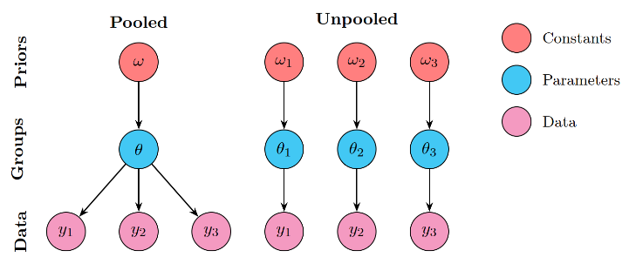
Two extreme options
Pretend groups don’t exist
Make ‘pooled’ parameter estimates
Only one set of group parameters
Pretend groups are unrelated
Make ‘unpooled’ parameter estimates
Each group has independent parameters

Slide 6
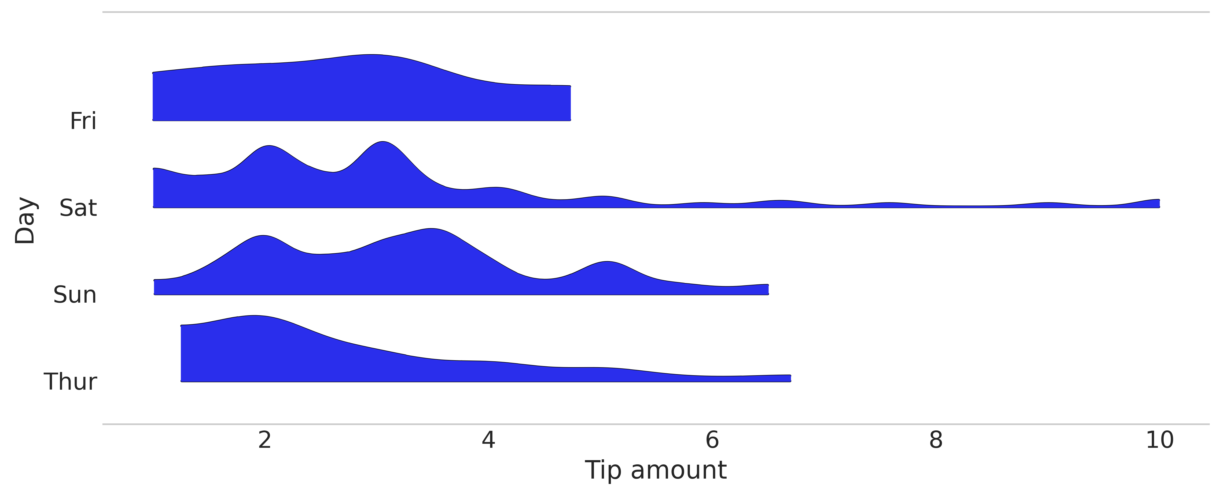
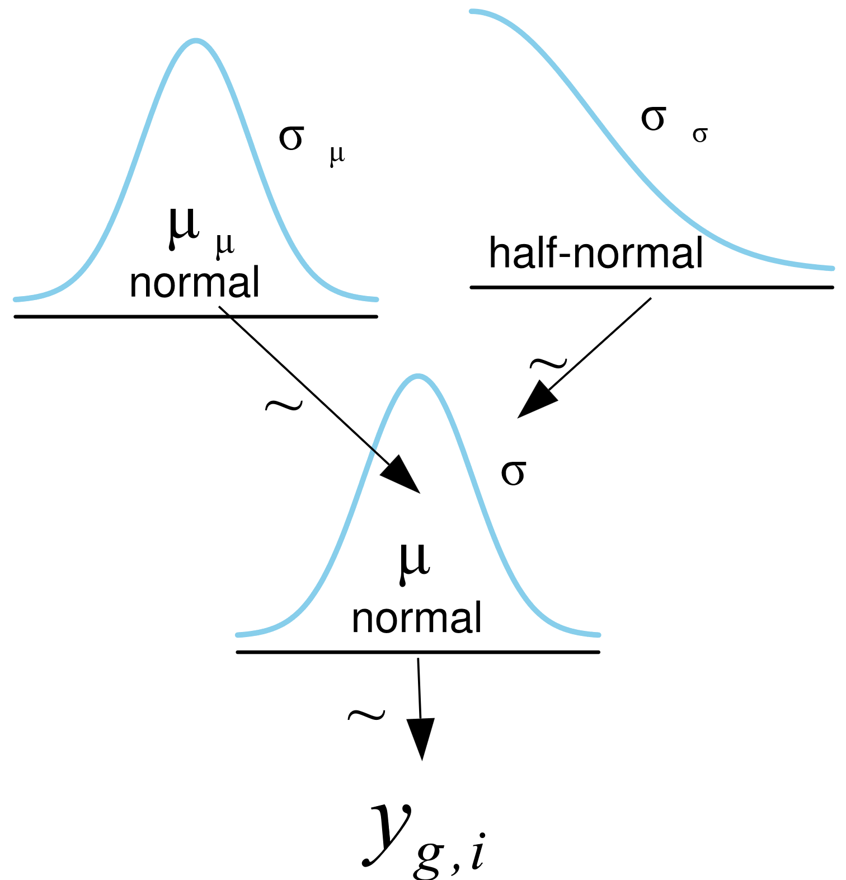
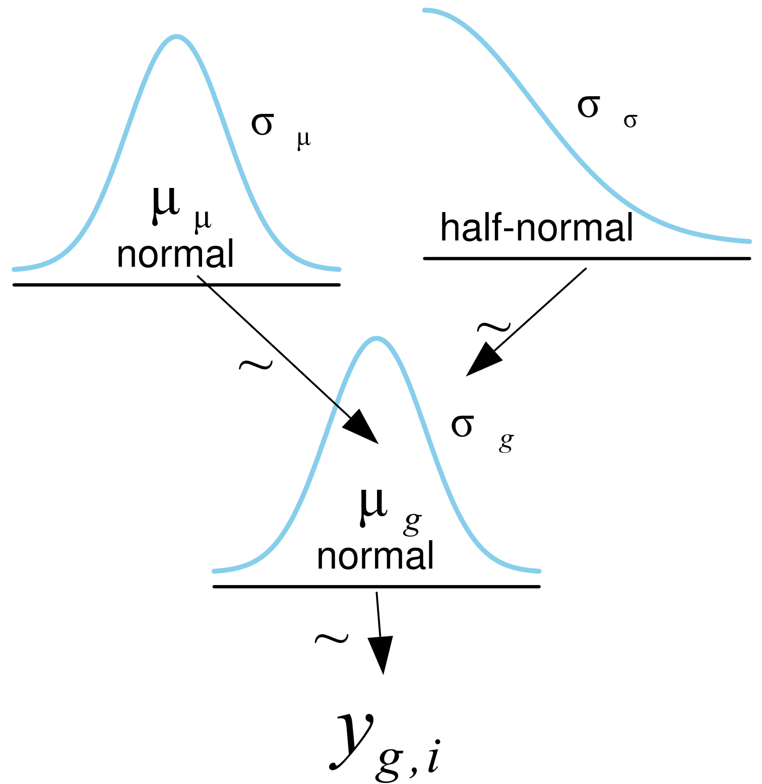
Tips data
4 groups
Pooled and unpooled models are possible
The unpooled model seems to have 1 prior
But it is really 4 identical priors
Pooled
Unpooled

Slide 7
Pooled and unpooled PyMC
PyMC would accept a vector for sigma in the HalfNormal
They really are different priors
Pooled
Unpooled
with pm.Model(coords=pooled_coords) as pooled_model:
μ = pm.HalfNormal("μ", sigma=σ_μ)
σ = pm.HalfNormal("σ", sigma=σ_σ)
y = pm.Gamma("y", mu=μ, sigma=σ, observed=tip, dims="data")
with pm.Model(coords=unpooled_coords) as unpooled_model:
μ = pm.HalfNormal("μ", sigma=σ_μ, dims="days")
σ = pm.HalfNormal("σ", sigma=σ_σ, dims="days")
y = pm.Gamma("y", mu=μ[idx], sigma=σ[idx], observed=tip, dims="days_flat")

Slide 8
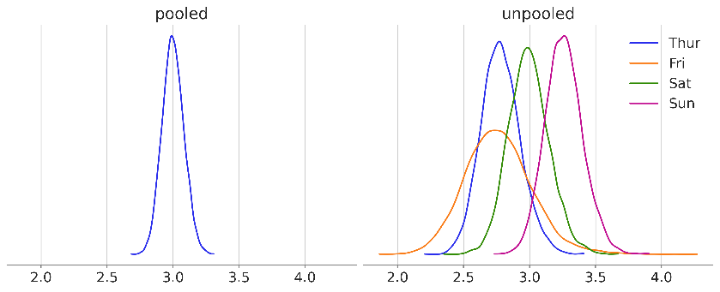
Pooled and unpooled posteriors
Pooled model
Less uncertainty
Shared information
Unpooled model
Parameters for each group
Information is not pooled

Slide 9
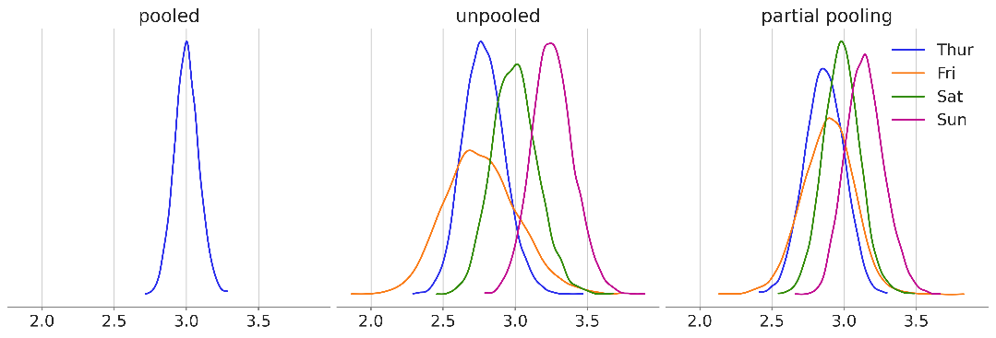
Partial pooling
Information sharing across groups
Separate parameters for each group

Slide 10
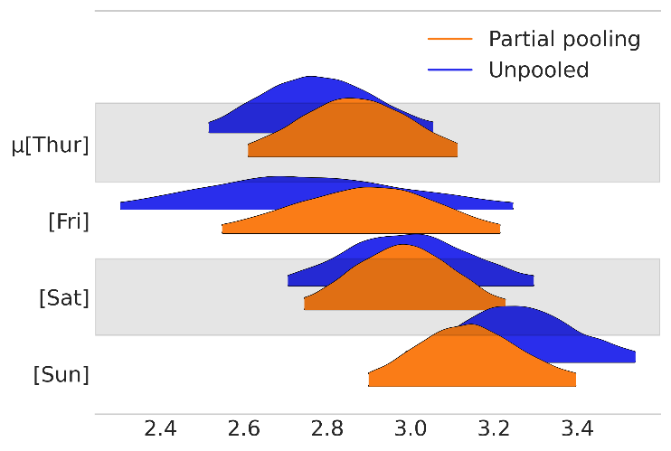
Compre the results
az.plot_forest([idatas["unpooled"], idatas["partial pooling"]],
var_names="μ", model_names=["Unpooled", "Partial pooling"],
kind="ridgeplot",
combined=True, figsize=(6, 4))
Partial pooling:
More narrow HDIs
Closer together

Slide 11
Rewriting our models
Constant
Parameter
Data
Colors for type of variable
Add the implicit parameters of the prior

Slide 12
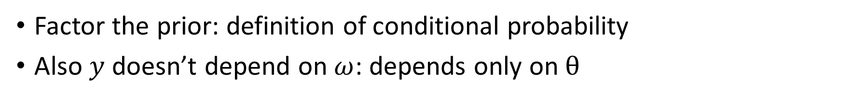
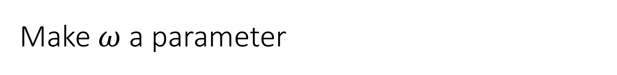
Make $ω$ a parameter
Factor the prior: definition of conditional probability
Also $y$ doesn’t depend on $ω$: depends only on $θ$

Slide 13
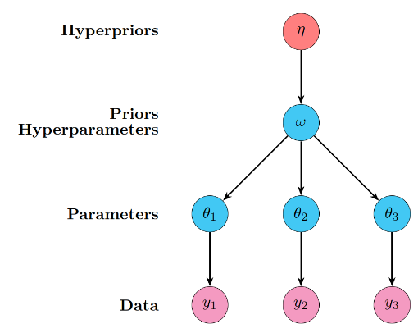
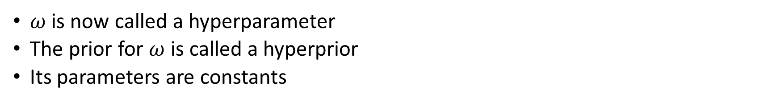
Hyperparameters and hyperpriors
$ω$ is now called a hyperparameter
The prior for $ω$ is called a hyperprior
Its parameters are constants

Slide 14
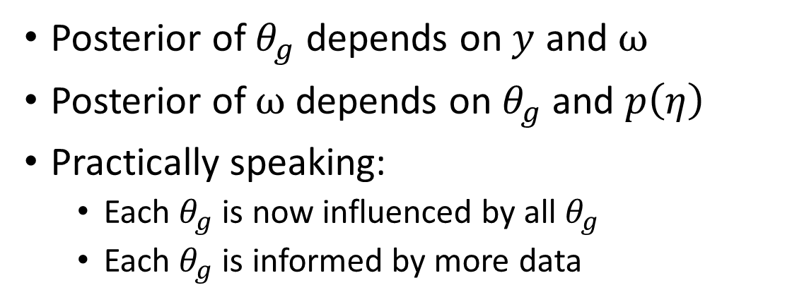
The hierarchical model
Posterior of $θ_{g}$ depends on $y$ and $ω$
Posterior of $ω$depends on $θ_{g}$ and $p\left(η\right)$
Practically speaking:
Each $θ_{g}$ is now influenced by all $θ_{g}$
Each $θ_{g}$ is informed by more data

Slide 15
7C Hierarchical models in PyMC

Slide 16
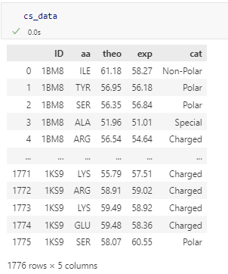
Chemical shift data: theory and experiment
Data columns:
Protein ID code
Amino acid within the protein
Theoretical value for chemical shift
Experimental value for chemical shift
Protein category
We will look at the difference between theory and experiment

Slide 17
Chemical shift data: theory and experiment
Pooled model
Ignore the amino acid
Unpooled model
Ignore similarity between amino acids
Partially pooled model
Hierarchical sharing of data

Slide 18
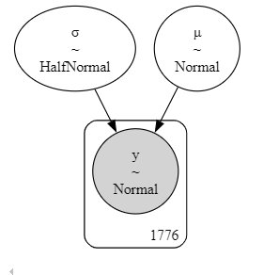
The pooled model
with pm.Model(coords=coords) as cs_p:
μ = pm.Normal('μ', mu=μ_μ, sigma=σ_μ)
σ = pm.HalfNormal('σ', sigma=σ_σ)
y = pm.Normal('y', mu=μ, sigma=σ, observed=diff)

Slide 19
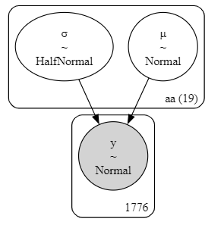
The unpooled model
with pm.Model(coords=coords) as cs_nh:
μ = pm.Normal('μ', mu=μ_μ, sigma=σ_μ, dims="aa")
σ = pm.HalfNormal('σ', sigma=σ_σ, dims="aa")
y = pm.Normal('y', mu=μ[idx], sigma=σ[idx], observed=diff)

Slide 20
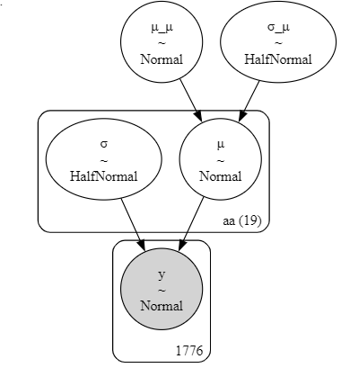
The hierarchical model
with pm.Model(coords=coords) as cs_h:
# hyper_priors
μ_μ = pm.Normal('μ_μ', mu=μ_μμ, sigma=σ_μμ)
σ_μ = pm.HalfNormal('σ_μ', σ_σμ)
# priors
μ = pm.Normal('μ', mu=μ_μ, sigma=σ_μ, dims="aa")
σ = pm.HalfNormal('σ', sigma=10, dims="aa")
y = pm.Normal('y', mu=μ[idx], sigma=σ[idx], observed=diff)

Slide 21
Comparing the models

Slide 22
Comparing the code
Pooled
Unpooled
with pm.Model(coords=coords) as cs_p:
μ = pm.Normal('μ', mu=μ_μ, sigma=σ_μ)
σ = pm.HalfNormal('σ', sigma=σ_σ)
y = pm.Normal('y', mu=μ, sigma=σ, observed=diff)
with pm.Model(coords=coords) as cs_nh:
μ = pm.Normal('μ', mu=μ_μ, sigma=σ_μ, dims="aa")
σ = pm.HalfNormal('σ', sigma=σ_σ, dims="aa")
y = pm.Normal('y', mu=μ[idx], sigma=σ[idx], observed=diff)
Hierarchical
with pm.Model(coords=coords) as cs_h:
# hyper_priors
μ_μ = pm.Normal('μ_μ', mu=μ_μμ, sigma=σ_μμ)
σ_μ = pm.HalfNormal('σ_μ', σ_σμ)
# priors
μ = pm.Normal('μ', mu=μ_μ, sigma=σ_μ, dims="aa")
σ = pm.HalfNormal('σ', sigma=10, dims="aa")
y = pm.Normal('y', mu=μ[idx], sigma=σ[idx], observed=diff)

Slide 23
7D What does the hierarchy do?

Slide 24
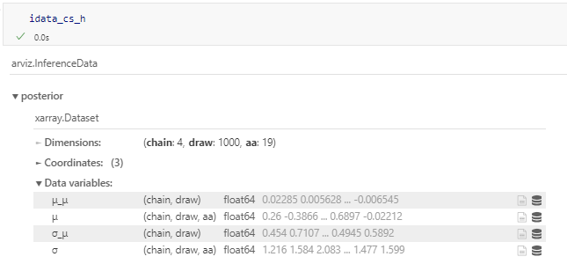
Hyperparameters are just parameters
Each MCMC sample contains a full set:
μ_μ, σ_μ
μ[aa], σ[aa]

Slide 25
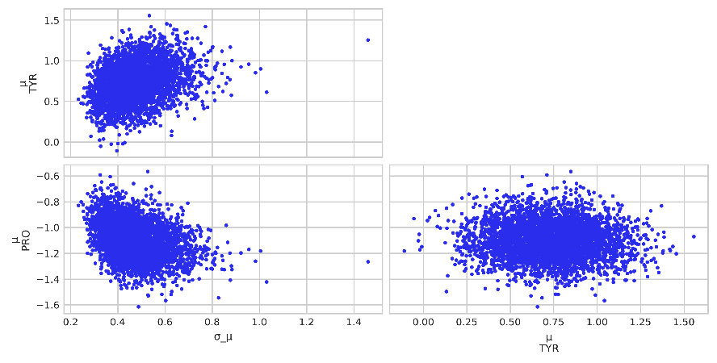
The parameters and hyperparameters are related
σ_μ is smaller when the μ are closer together
And vice versa

Slide 26
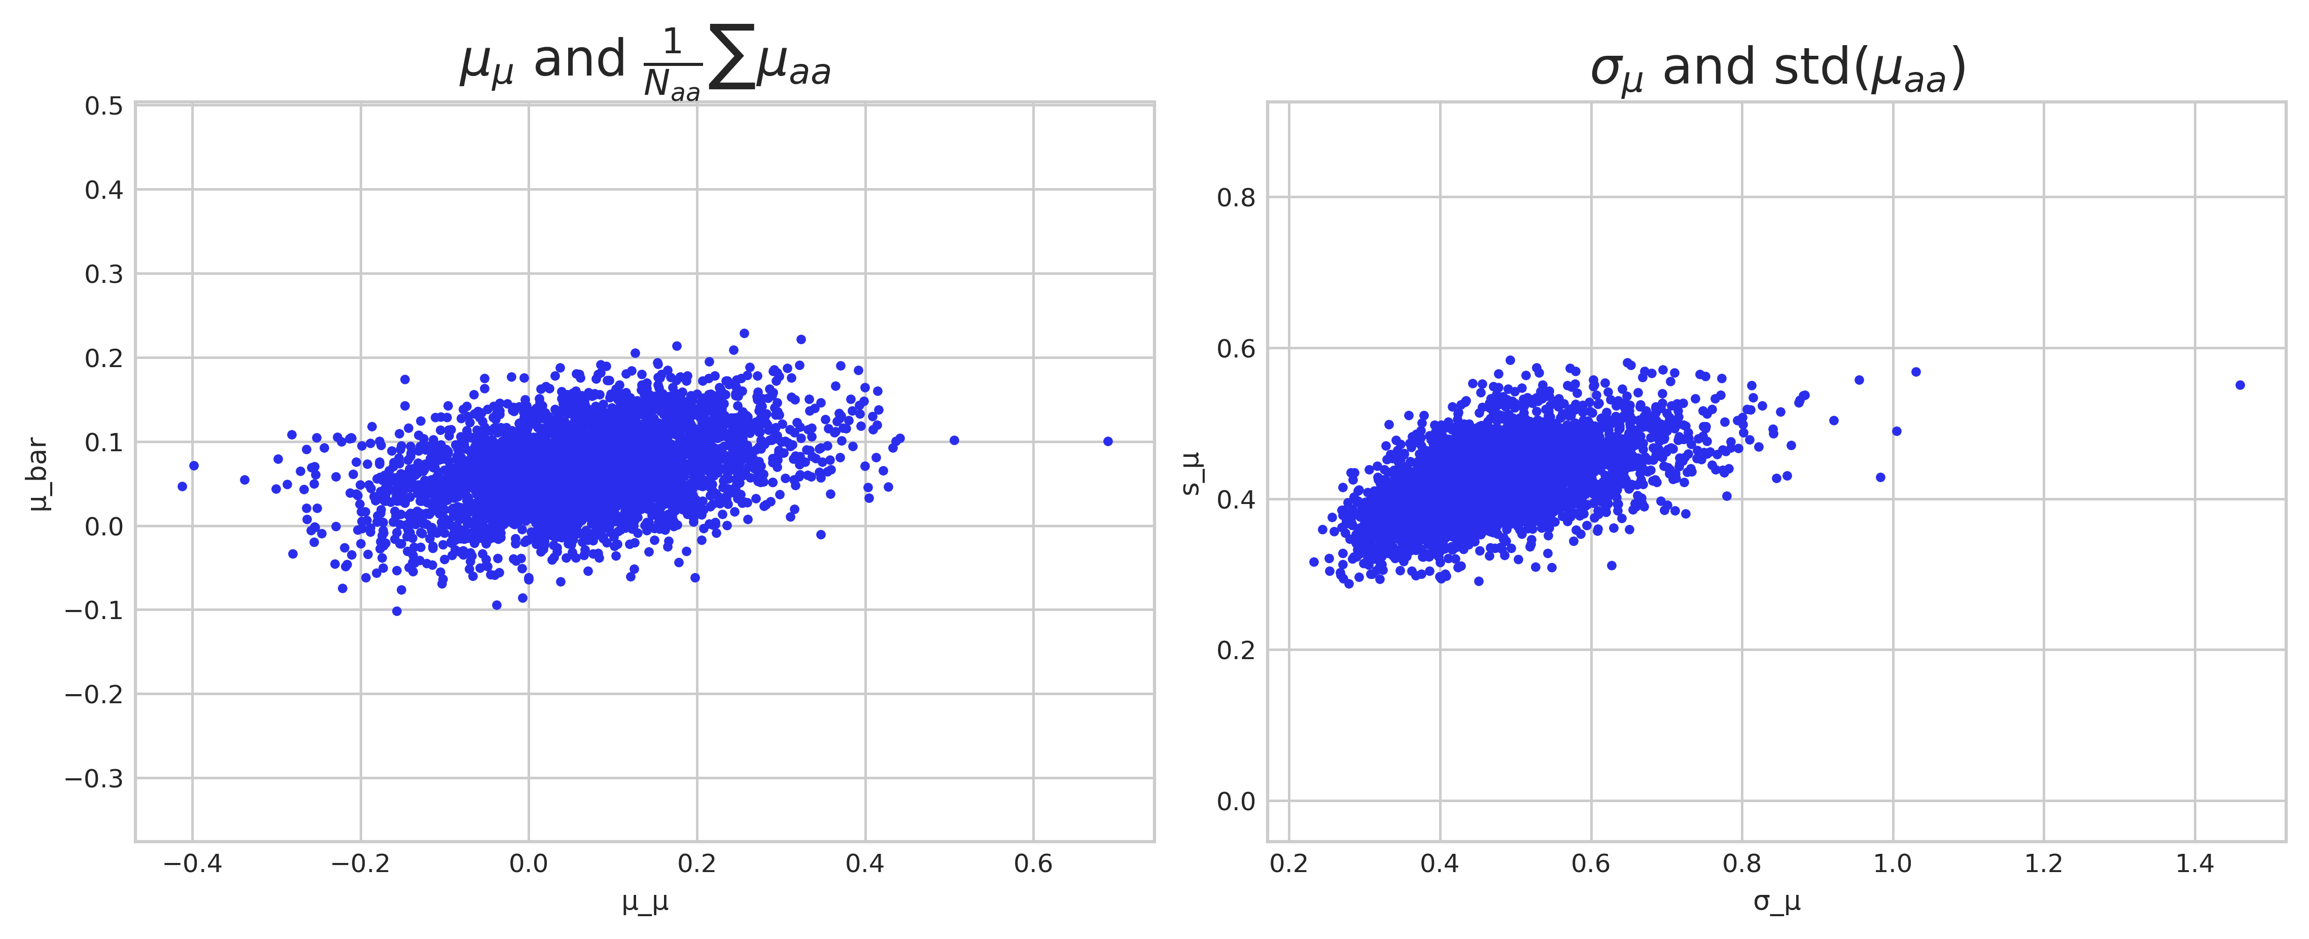
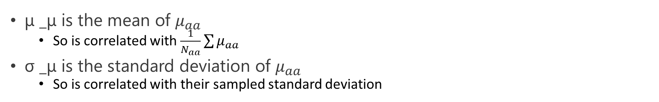
Summary statistics of the parameters
μ _μ is the mean of $μ_{aa}$
So is correlated with $\frac{1}{N_{aa}}\sum{μ_{aa}}$
σ _μ is the standard deviation of $μ_{aa}$
So is correlated with their sampled standard deviation

Slide 27
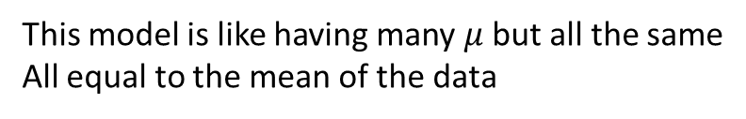
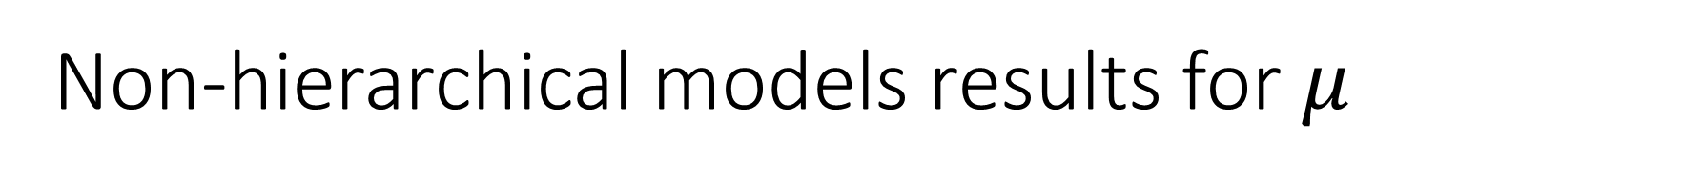
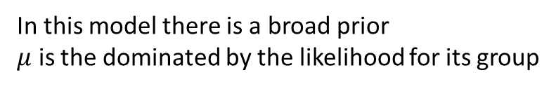
Non-hierarchical models results for $μ$
Pooled
Unpooled
with pm.Model(coords=coords) as cs_p:
μ = pm.Normal('μ', mu=μ_μ, sigma=σ_μ)
σ = pm.HalfNormal('σ', sigma=σ_σ)
y = pm.Normal('y', mu=μ, sigma=σ, observed=diff)
with pm.Model(coords=coords) as cs_nh:
μ = pm.Normal('μ', mu=μ_μ, sigma=σ_μ, dims="aa")
σ = pm.HalfNormal('σ', sigma=σ_σ, dims="aa")
y = pm.Normal('y', mu=μ[idx], sigma=σ[idx], observed=diff)
This model is like having many $μ$ but all the same
All equal to the mean of the data
In this model there is a broad prior
$μ$ is the dominated by the likelihood for its group

Slide 28
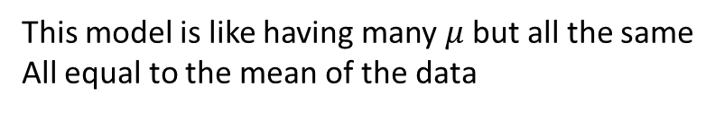
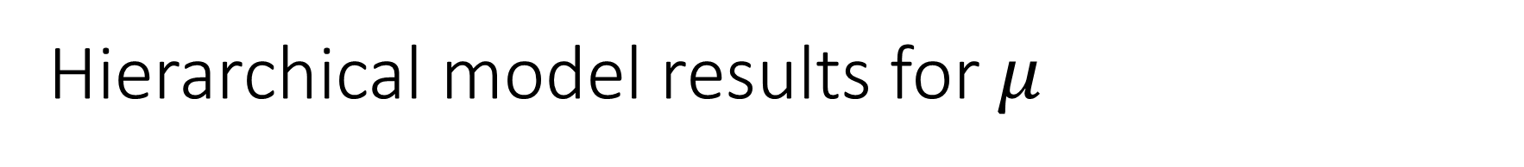
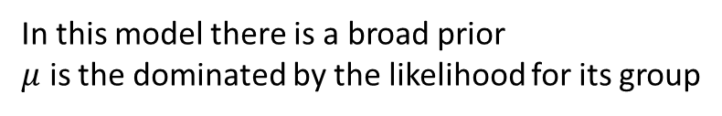
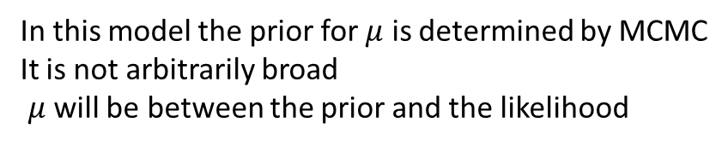
Hierarchical model results for $μ$
Pooled
Unpooled
This model is like having many $μ$ but all the same
All equal to the mean of the data
In this model there is a broad prior
$μ$ is the dominated by the likelihood for its group
Hierarchical
with pm.Model(coords=coords) as cs_h:
# hyper_priors
μ_μ = pm.Normal('μ_μ', mu=μ_μμ, sigma=σ_μμ)
σ_μ = pm.HalfNormal('σ_μ', σ_σμ)
# priors
μ = pm.Normal('μ', mu=μ_μ, sigma=σ_μ, dims="aa")
σ = pm.HalfNormal('σ', sigma=10, dims="aa")
y = pm.Normal('y', mu=μ[idx], sigma=σ[idx], observed=diff)
In this model the prior for $μ$ is determined by MCMC
It is not arbitrarily broad
$μ$ will be between the prior and the likelihood

Slide 29
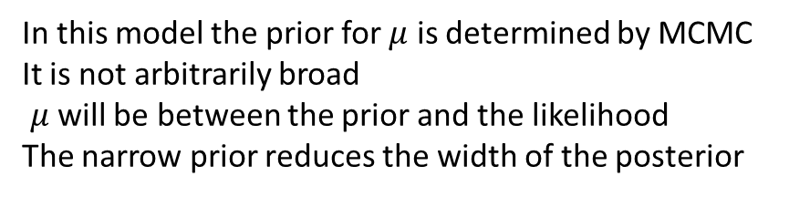
Hierarchical models create data-driven narrow priors
Pooled
Unpooled
This model is like having many $μ$ but all the same
All equal to the mean of the data
In this model there is a broad prior
$μ$ is the dominated by the likelihood for its group
Hierarchical
In this model the prior for $μ$ is determined by MCMC
It is not arbitrarily broad
$μ$ will be between the prior and the likelihood
The narrow prior reduces the width of the posterior
Pooled model σ_μ: 0
Hierarchical model σ_μ: 0.47 ± 0.10
Unpooled model σ_μ: 10
Pooled model std(μ): 0
Hierarchical model std(μ): 0.42 ± 0.05
Unpooled model std(μ): 0.51 ± 0.05

Slide 30
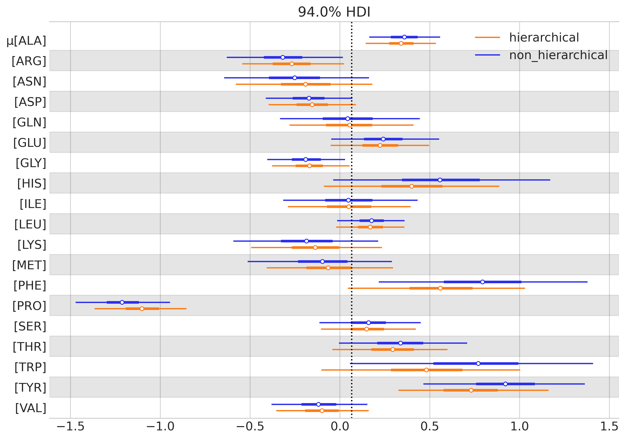
Shrinkage and reduced uncertainty

Slide 31
7E Benefits and pitfalls

Slide 32
Benefits and pitfalls of hierarchical models
Benefits
Pitfalls
Model structured data
Balance
Population information
Group information
Robust estimation
Even if some groups have less data
Computational complexity
Increased fitting time
Importance of sampling diagnostics
Priors disconnected from data
Importance of prior predictive
Interpretational complexity
Simultaneous interpretation at multiple levels

Slide 33
7F Multiple levels of hierarchy

Slide 34
7F Hierarchical regression

Slide 35
7G Group-level effects

Slide 36
7H Bayesian workflow

